Slide 1
Introduction to Tflite
HAI Lab
김대현
2021.03.25

Slide 2
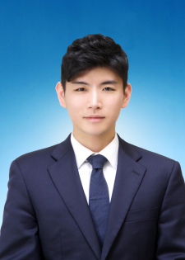

발표자 소개
□ 소개 및 프로필
김대현 (Dae-Hyun Kim)
- Human AI interaction Lab
- 석사과정 (2020.03 ~ )
관심 연구 분야
- Machine Learning Algorithms
- Mobile App
HAI Lab Seminar

Slide 3
Perpose
What is Tflite?
Why use Tflite?
How to use Tflite?
HAI Lab Seminar

Slide 4
Contents
Introduction to Tflite
Ready to use Tflite
Applications
HAI Lab Seminar

Slide 5

Introduction to Tflite
01
What is Tflite?
+
lite
Q1. Why did google lighten the Tensorflow?
Q2. What is the meaning of ‘lite’ in tflite?
HAI Lab Seminar

Slide 6




Introduction to Tflite
01
Q1. Why did google lighten the Tensorflow?
HAI Lab Seminar

Slide 7
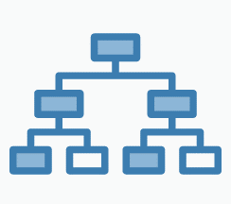








Introduction to Tflite
01
Q1. Why did google lighten the Tensorflow?
Edge Device
AI
etc..
etc..
HAI Lab Seminar

Slide 8
Introduction to Tflite
01
What is Tflite?
+
lite
Q1. Why did google lighten the Tensorflow?
Q2. What is the meaning of ‘lite’ in tflite?
HAI Lab Seminar

Slide 9

Introduction to Tflite
01
Q2. What is the meaning of ‘lite’ in tflite?
Model Optimization
(Quantization)
KB size
11,738 / 3,906 = 3.005
HAI Lab Seminar
Notes:
Optimization의 필요 요소에는 size reductio과 latency reduction 등이 있습니다.
Tflite에서 모델의 용량을 줄이기 위해 quantization이라는 것을 사용했습니다.

Slide 10
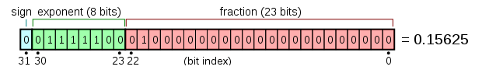
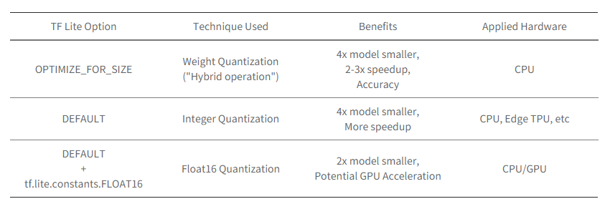
Introduction to Tflite
01
Quantization
Fig.1 32bit floating point(ref : Wikipedia)
Fig.2 TF Lite Option Table (ref : TF Lite Documentation)
HAI Lab Seminar

Slide 11


Introduction to Tflite
01
Example – Mnist
Edge Device
AI
etc..
etc..
HAI Lab Seminar

Slide 12
목차
Introduction to Tflite
Ready to use Tflite
Applications
HAI Lab Seminar

Slide 13
Ready to use Tflite
02
How to make Tflite
Step 1. Train out model
Step 2. Convert model to tflite
HAI Lab Seminar

Slide 14
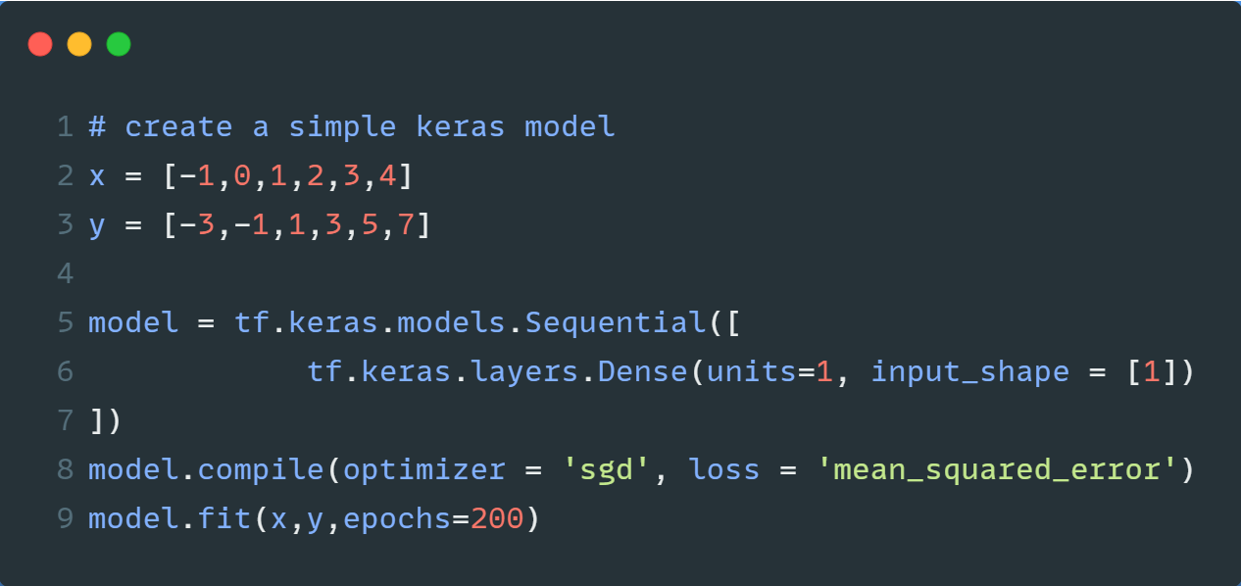
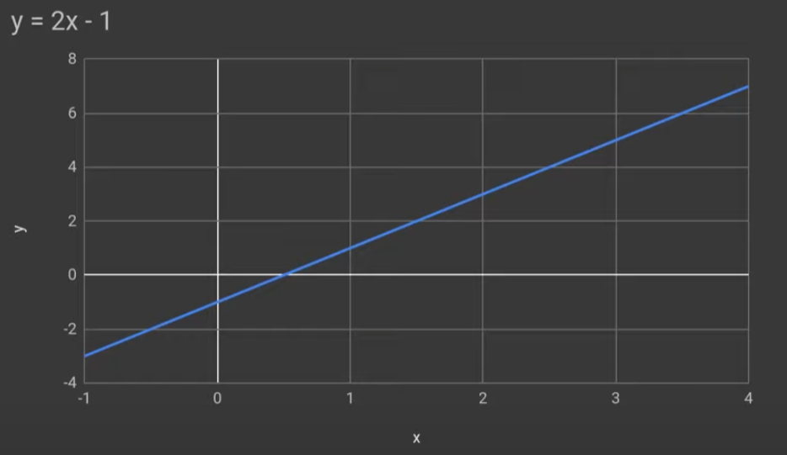
Ready to use Tflite
02
Step 1. Train out model – Linear Regression
HAI Lab Seminar

Slide 15
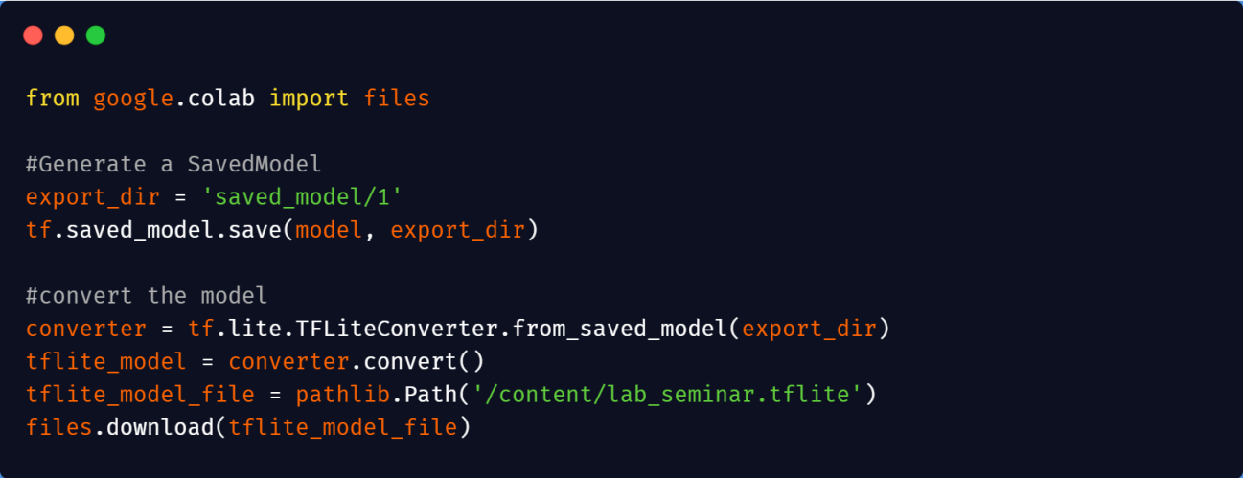


Ready to use Tflite
02
Step 2. Convert model to tflite – Linear Regression
Saved_model.pd
Lab_seminar.tflite
HAI Lab Seminar

Slide 16
목차
Introduction to Tflite
Ready to use Tflite
Applications
HAI Lab Seminar

Slide 17


Applications
03
Road to use Tflite
Step 1. Train out model
Step 2. Convert model to tflite
Step 3. Make android studio project
Step 4. Update gradle file
Step 5. Make assets folder & Add tflite file
HAI Lab Seminar

Slide 18


Applications
03
Intro
Swift
Objective – c
Java
Kotlin
Xcode
Android Studio
HAI Lab Seminar

Slide 19
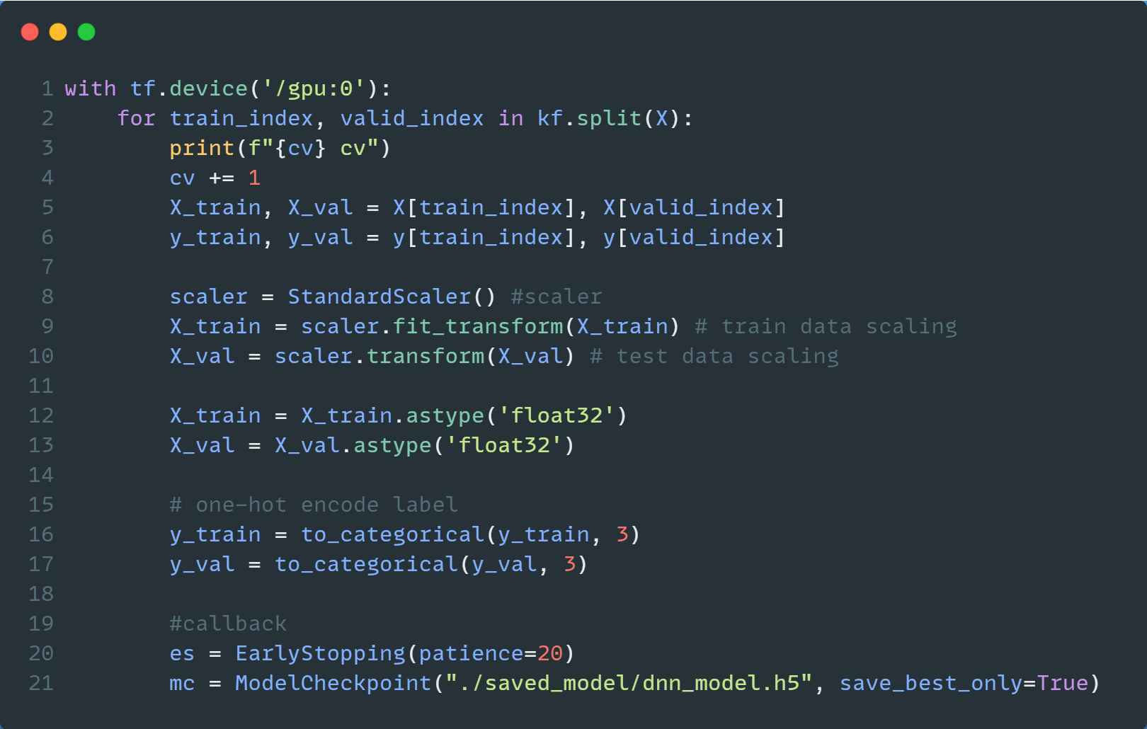
Applications
03
Step 1. Train out model – Our project
dnn_model.h5
HAI Lab Seminar

Slide 20
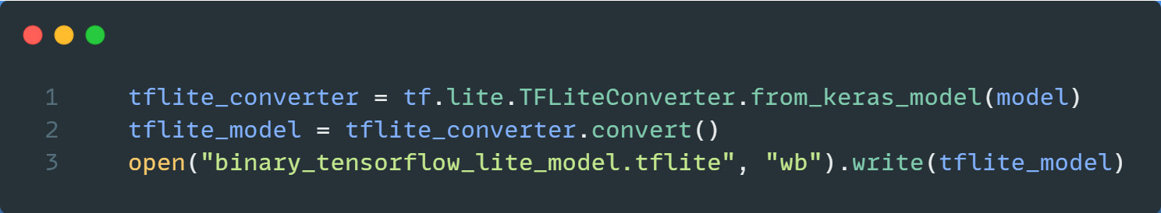
Applications
03
Step 2. Convert model to tflite – Our project
dnn_model.h5
Binary_tensorflow
_lite_model.tflite
HAI Lab Seminar

Slide 21
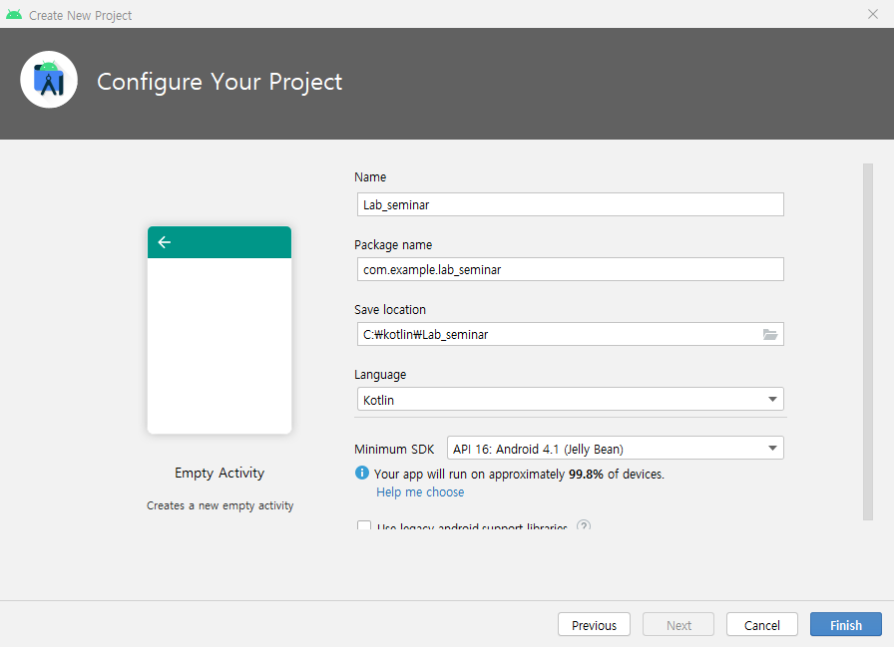
Applications
03
Step 3. Make your android studio project (in android studio)
HAI Lab Seminar

Slide 22
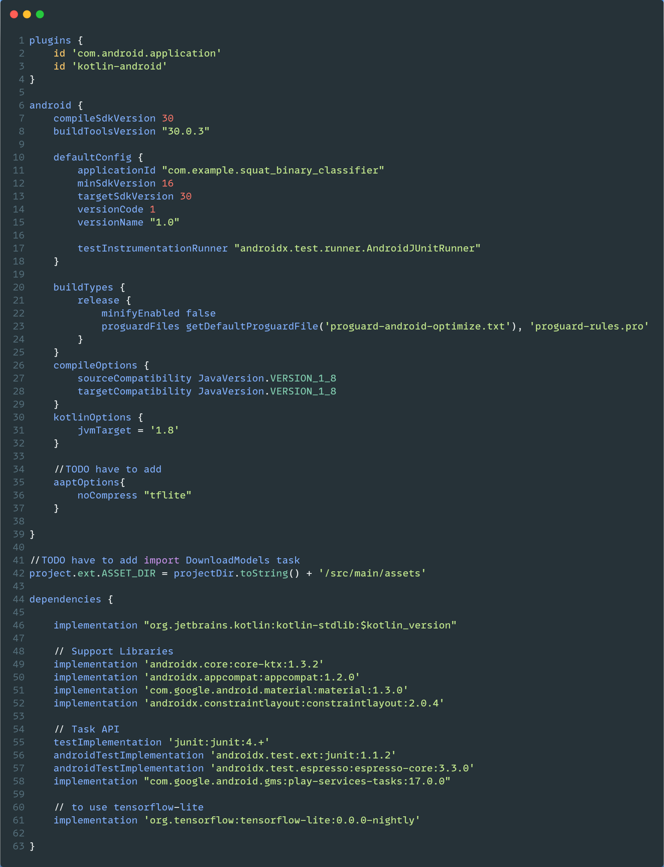
Applications
03
Step 4. Update gradle file (in android studio)
What to update gradle file
Add aaptOptions
Add projectDir
Update dependencies
HAI Lab Seminar

Slide 23
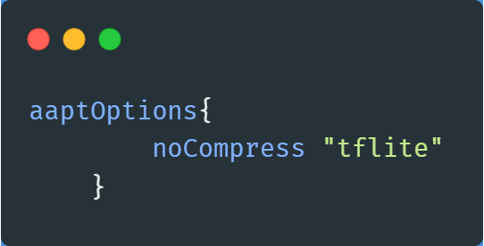
Applications
03
Step 4. Update gradle file - Add aaptOptions
Add aaptOptions
Add projectDir
Update dependencies
HAI Lab Seminar

Slide 24
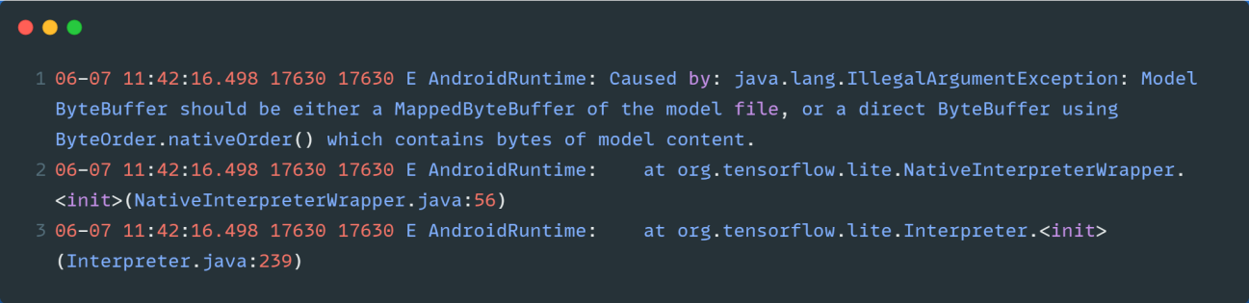
Applications
03
Step 4. Update gradle file - Add aaptOptions
cf) If you do not add aaptOptions..
HAI Lab Seminar

Slide 25
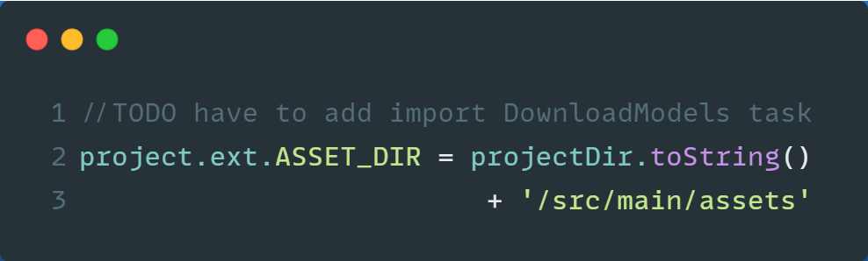
What to update gradle file
Applications
03
Step 4. Update gradle file - Add projectDir
Add aaptOptions
Add projectDir
Update dependencies
HAI Lab Seminar

Slide 26

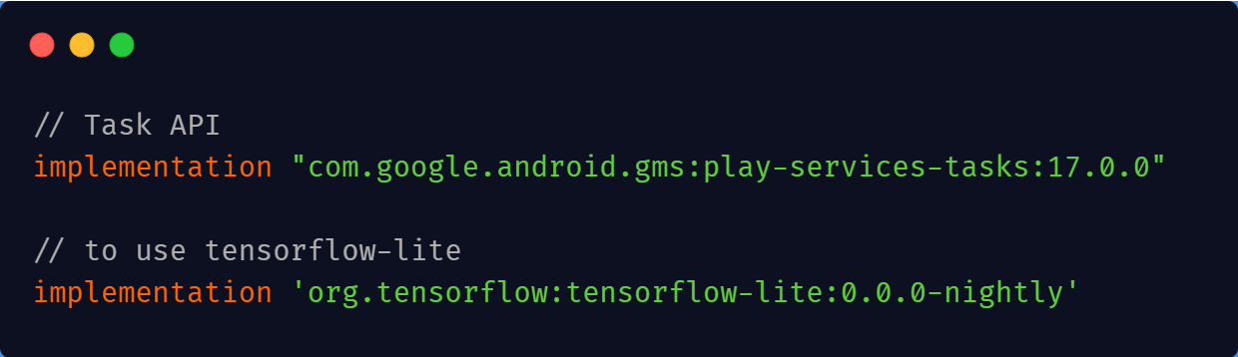
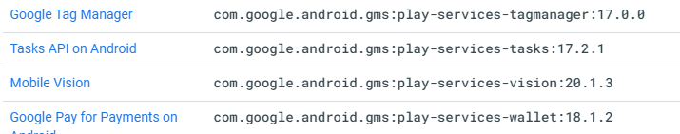
Applications
03
Step 4. Update gradle file - Update dependencies
Add aaptOptions
Add projectDir
Update dependencies
s
HAI Lab Seminar

Slide 27
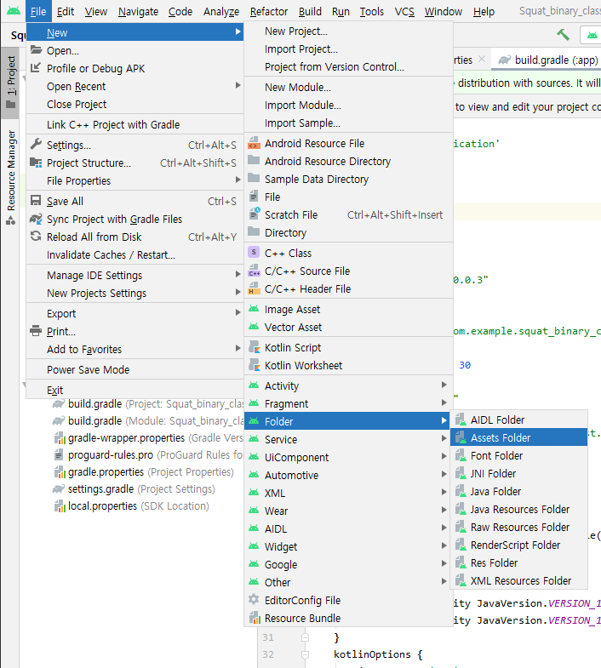
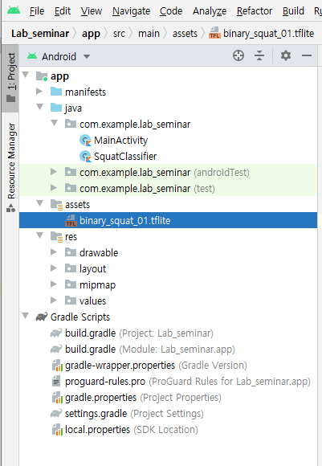
Applications
03
Step 5. Make assets folder & Add tflite file
HAI Lab Seminar

Slide 28
Applications
03
Code Flow
Mainactivity.kt
SquatClassifier.kt
Squat!!
Step1. Read Sensor value
Step3. Receive Sensor value
Step2. Send Sensor value
Step5. Compare with threshold
Step4. Squat classifier
HAI Lab Seminar

Slide 29
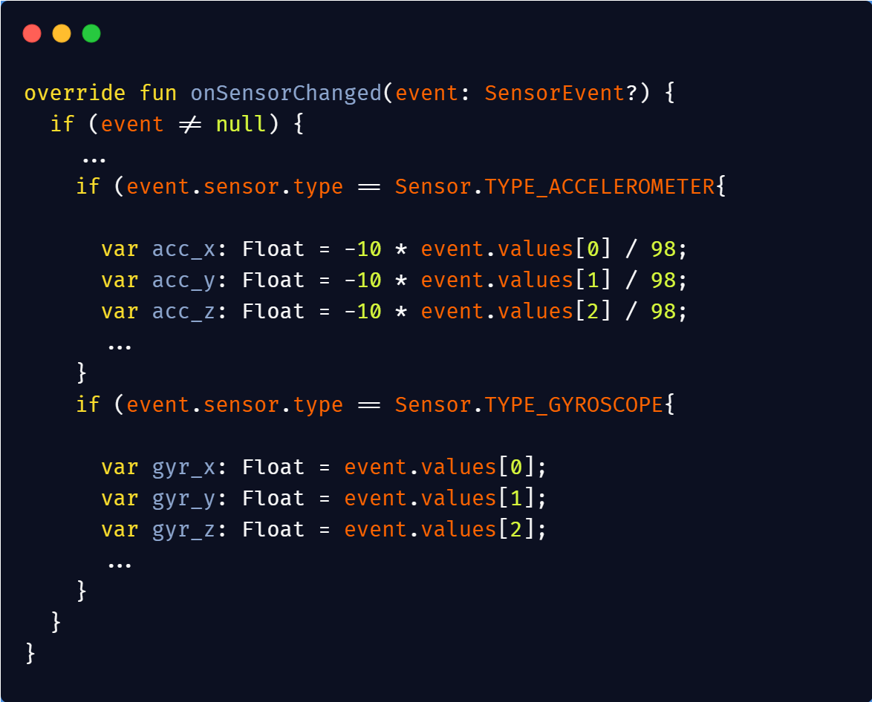
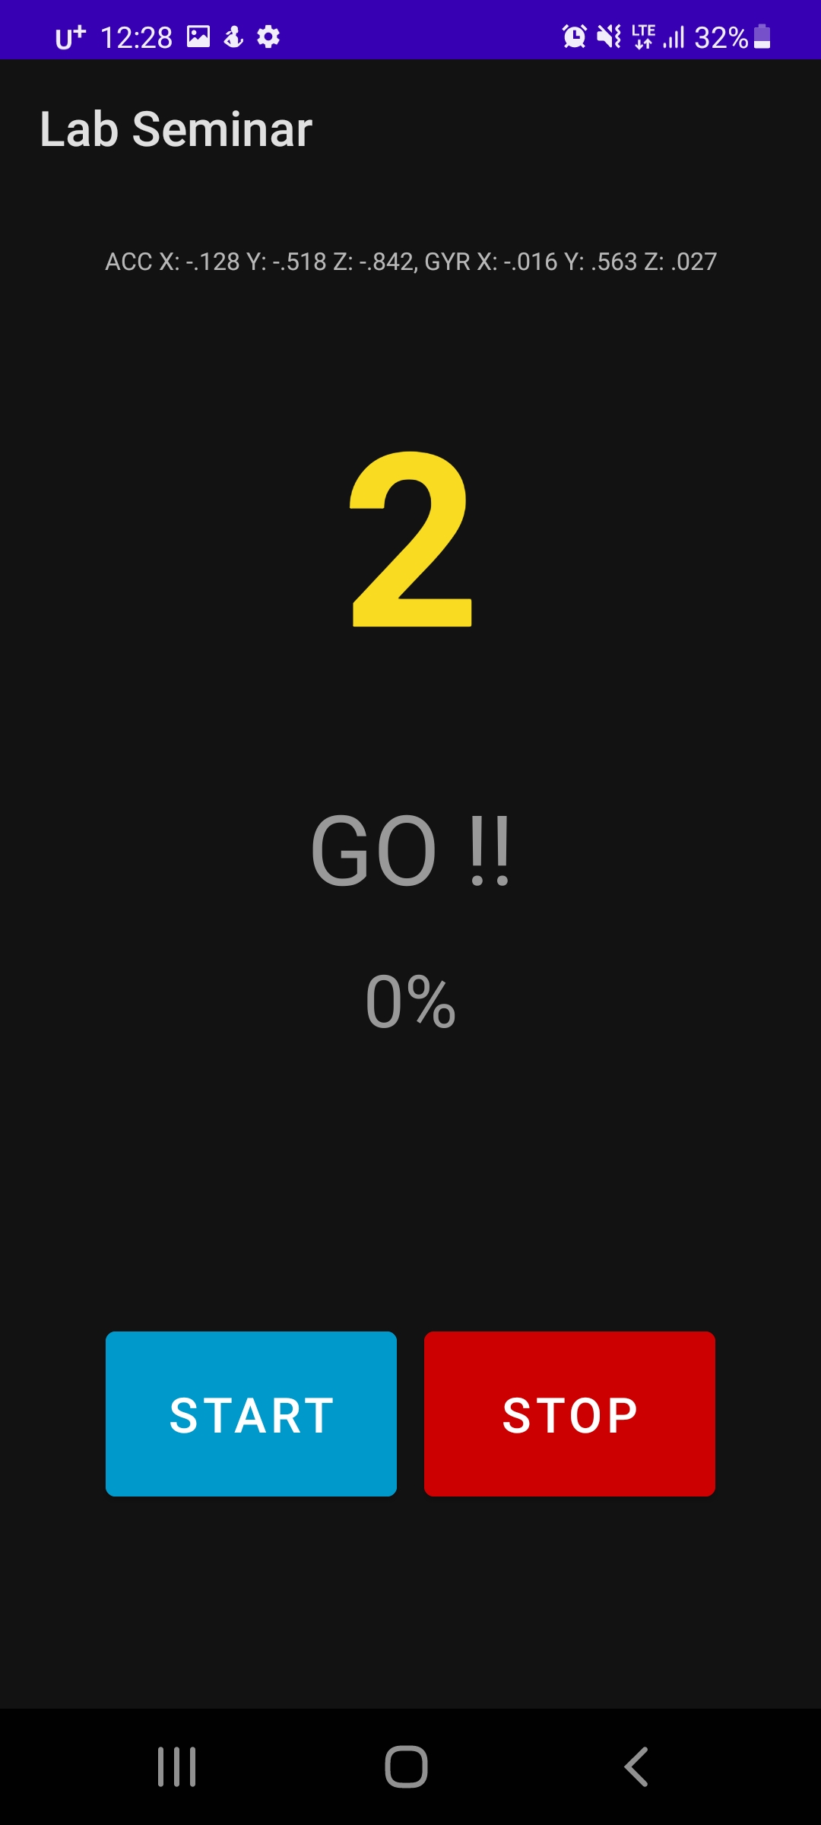
Applications
03
Step 1. Read sensor value (in Mainactivity.kt)
HAI Lab Seminar

Slide 30
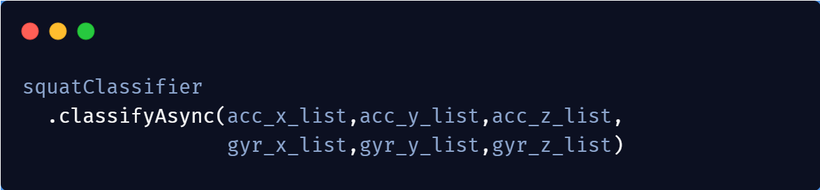
Applications
03
Step 2. Send sensor value (in Mainactivity.kt)
SQUAT_DATA ACC X: [0.020631991, 0.003235194, … , -0.13140851, -0.17065546, -0.07101099,,-0.048009057]
SQUAT_DATA ACC Y: [-0.9874056, -1.010174, … , -0.015423893, -0.027564483, -0.0022143214, -0.920901]
…
SQUAT_DATA GYR Z: [-0.018554486, 0.007406523, -0.01977618, … ,… ,… ]
HAI Lab Seminar

Slide 31
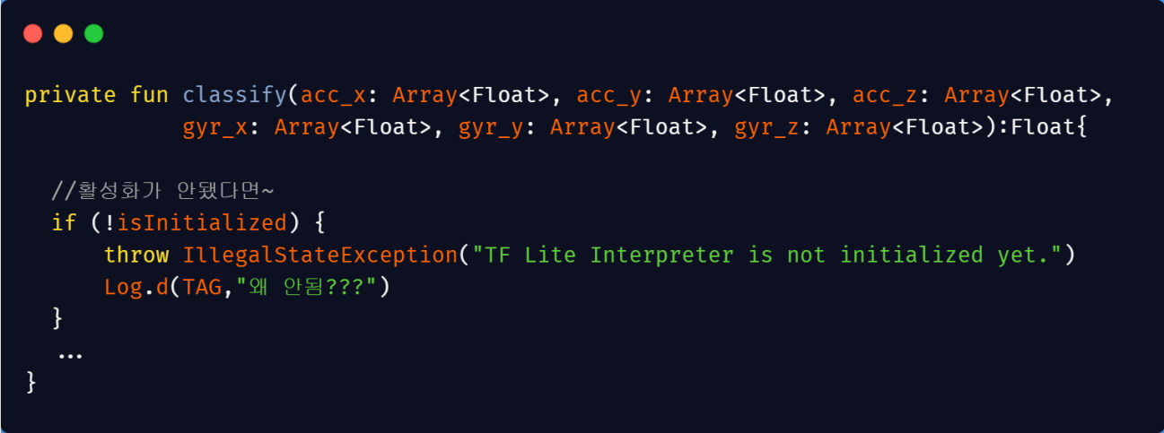
Applications
03
Step 3. Receive sensor value (in SquatClassifier.kt)
HAI Lab Seminar
Notes:
,

Slide 32
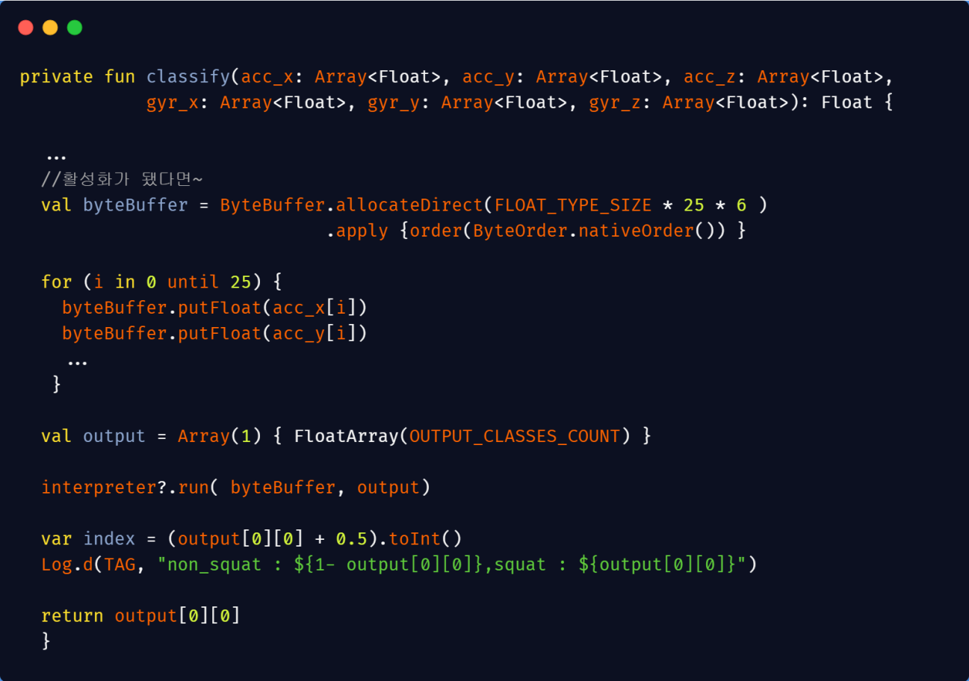
Applications
03
Step 4. Classify Squat (in SquatClassifier.kt)
HAI Lab Seminar

Slide 33
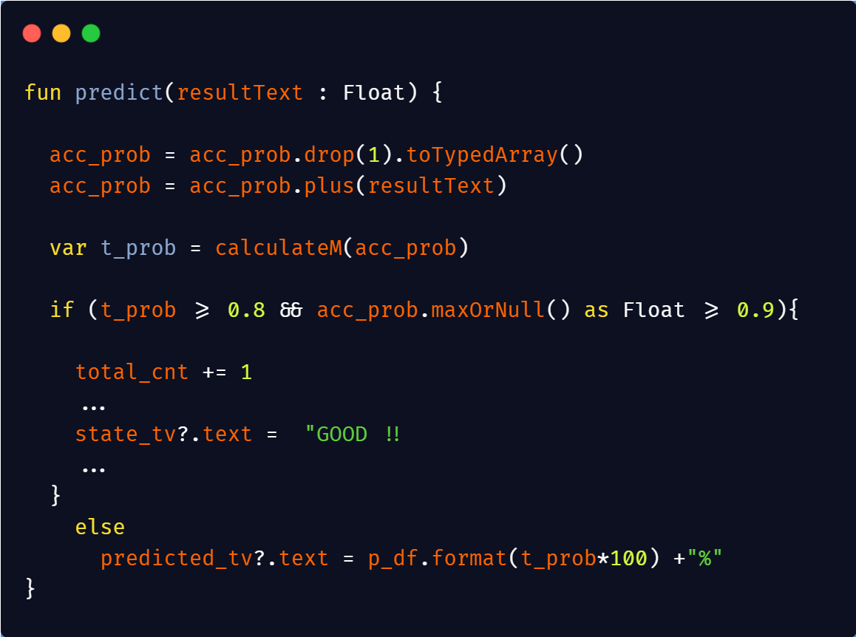
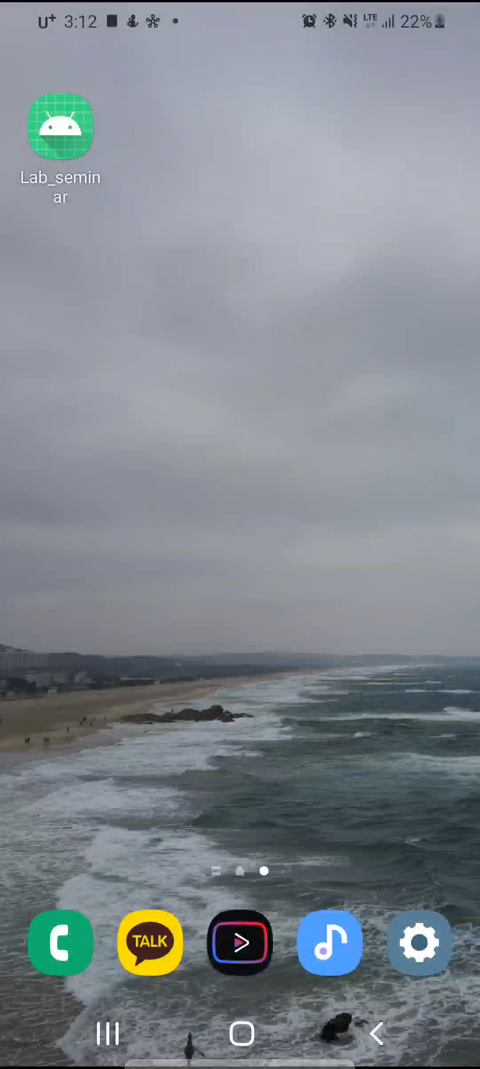
Applications
03
Step 5. Compare with threshold (in Mainactivity.kt)
HAI Lab Seminar

Slide 34
04
ref
Quantization Aware Training with TensorFlow Model Optimization Toolkit - Performance with Accuracy — The TensorFlow Blog
Introduction to TensorFlow Lite – Udacity
TensorFlow Lite 개발자 프리뷰 공개 :: GOOD to GREAT (tistory.com)
파이쿵 :: 1. 텐서플로 라이트 : 안드로이드 기초(1) (tistory.com)
TensorFlow Lite 시작하기
TF Lite Deck - Sayak - Google Slides
HAI Lab Seminar

